Slide 1
TSQL JOINS

Slide 2
INNER JOIN
OUTER JOINS
CROSS JOINS

Slide 3
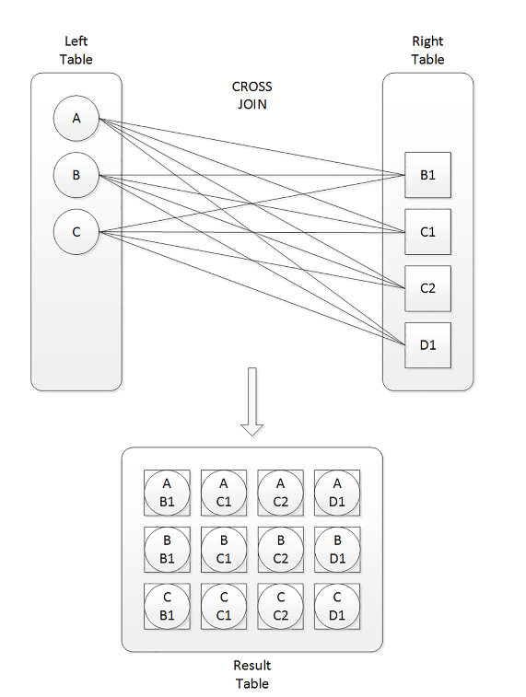
CROSS JOIN
Cartesian product
sides. If you have m rows in table T1 and n rows in table T2, the result of a cross join between T1 and T2 is a virtual table with m × n rows.

Slide 4
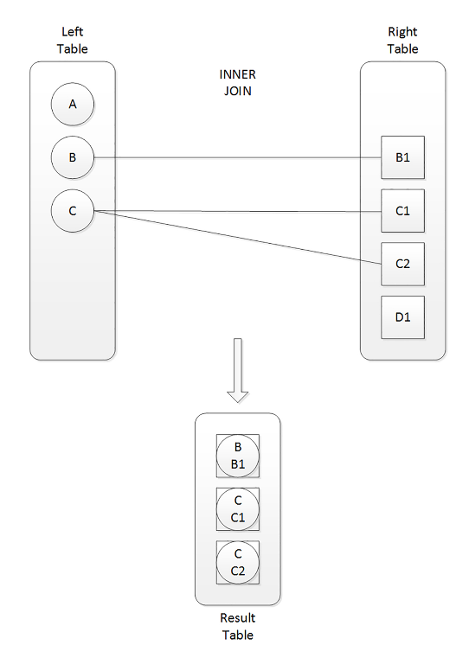
INNER JOIN
With an inner join, you can match rows from two tables based on a predicate—usually one that compares a primary key value in one side to a foreign key value in another side.

Slide 5
Excercise
Use the AdventureWorks2014 database to complete this exercise.
1. The HumanResources.Employee table does not contain the employee names. Join that table to the Person.Person table on the BusinessEntityID column. Display the job title, birth date, first name, and last name.
2. The customer names also appear in the Person.Person table. Join the Sales.Customer table to the Person.Person table. The BusinessEntityID column in the Person.Person table matches the PersonID column in the Sales.Customer table. Display the CustomerID, StoreID, and TerritoryID columns along with the name columns.
3. Extend the query written in question 2 to include the Sales.SalesOrderHeader table. Display the SalesOrderID column along with the columns already specified. The Sales.SalesOrderHeader table joins the Sales.Customer table on CustomerID.
4. Write a query that joins the Sales.SalesOrderHeader table to the Sales.SalesPerson table. Join the BusinessEntityID column from the Sales.SalesPerson table to theSalesPersonID column in the Sales.

Slide 6
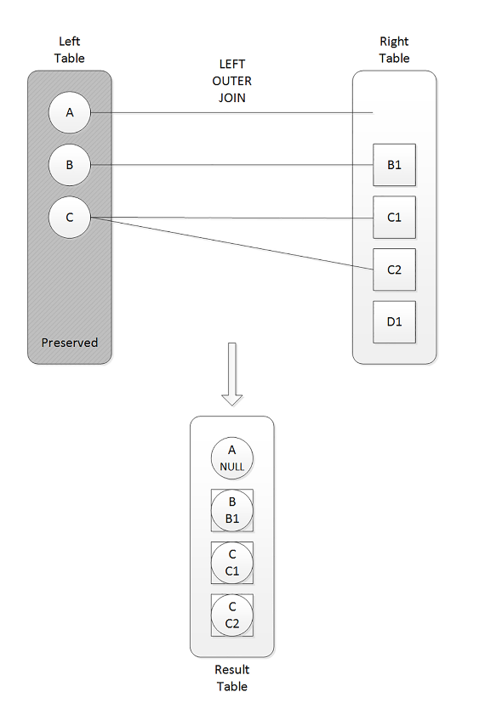
OUTER JOINS
With outer joins, you can request to preserve all rows from one or both sides of the join, never mind if there are matching rows in the other side based on the ON predicate.
the ON and WHERE clauses play very different roles, and therefore, they aren’t interchangeable.
Is the predicate used to filter or match?

Slide 7
FULL OUTER
A full outer join returns the matched rows, which are normally returned from an inner join; plus rows from the left that don’t have matches in the right, with NULL.
plus rows from the right that don’t have matches in the left, with NULLs used as placeholders in the left side.

Slide 8
Excercise
1. Write a query that displays all the products along with the SalesOrderID even if an order has never been placed for that product. Join to the Sales.SalesOrderDetail table using the ProductID column.
2. Change the query written in step 1 so that only products that have not been ordered show up in the query.
3. Write a query that returns all the rows from the Sales.SalesPerson table joined to the Sales.SalesOrderHeader table along with the SalesOrderID column even if no orders match. Include the SalesPersonID and SalesYTD columns in the results.
4. Change the query written in question 3 so that the salesperson’s name also displays from the Person.Person table.
5. The Sales.SalesOrderHeader table contains foreign keys to the Sales.CurrencyRate and Purchasing.ShipMethod tables. Write a query joining all three tables, and make sure it contains all rows from Sales.SalesOrderHeader. Include the CurrencyRateID, AverageRate, SalesOrderID, and ShipBase columns.

Slide 9
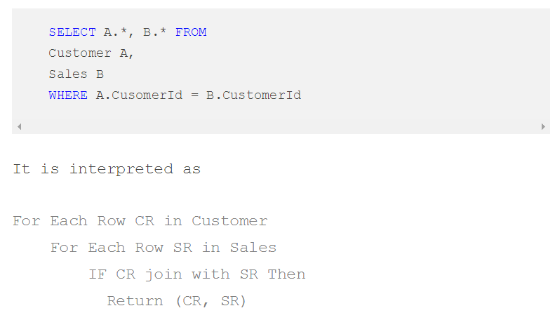
Nested Loop, Hash and Merge Joins
A Nested Join compares each row from the Outer table to each row from the Inner table looking for the rows which satisfy the Join predicate.
A nested loops join is particularly effective if the outer input is quite small and the inner input is pre-indexed and quite large.

Slide 10
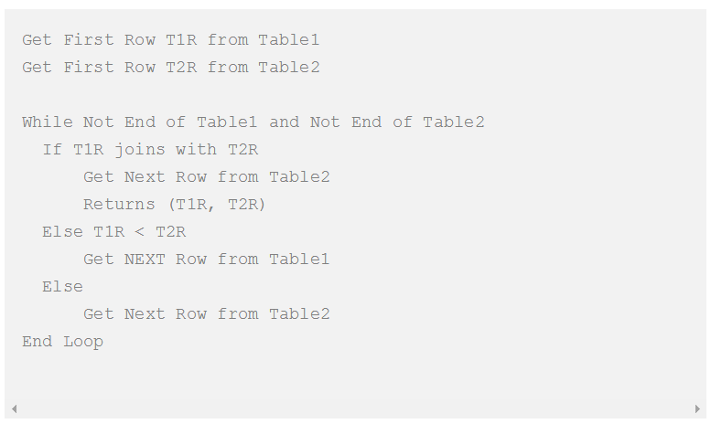
Merge join
The merge join requires that both inputs be sorted on the merge columns, which are defined by the equality (WHERE) clauses of the join predicate.
Because each input is sorted, the Merge Join operator gets a row from each input and compares them.
Merge join itself is very fast, but it can be an expensive choice if sort operations are required. However, if the data volume is large and the desired data can be obtained presorted from existing B-tree indexes, merge join is often the fastest available join algorithm.

Slide 11
Hash join
The hash join has two inputs: the build input and probe input. The query optimizer assigns these roles so that the smaller of the two inputs is the build input.
Hash Join is better suited for large tables. This requires less IO, but need more CPU and requires lot of memory.

Slide 12
Important
It’s important to remember that a join in T-SQL takes place conceptually between two tables at a time. A multi-join query evaluates the joins conceptually from left to right. So the result of one join is used as the left input to the next join.
you can end up with logical bugs, especially when outer joins are involved.

Slide 13
Writing subqueries
Using a Subquery in an IN List:
SELECT <select list> FROM <table1> WHERE <col1> IN (SELECT <col2> FROM <table2>)
Using a Subquery and NOT IN list:
SELECT <select list> FROM <table1> WHERE <col1> NOT IN (SELECT <col2> FROM <table2>)
Using a Subquery Containing NULL with NOT IN list
If the subquery contains any NULL values, using NOT IN will incorrectly produce no rows.

Slide 14
Exploring Derived Tables and Common Table Expressions
A derived table is a subquery that appears in the FROM clause. Actually, you may see derived tables with SQL Server 2005 and 2008 code, but starting with 2005, another option, common table expressions, is available.
SELECT <select list> FROM <table1> [INNER] JOIN (SELECT <select list> FROM <table2>) AS B ON <table1>.<col1> = B.<col2>
First, any columns that will be needed outside the derived table must be included in its SELECT list.
Second, the derived table requires an alias
the derived table may contain multiple tables, a WHERE clause, and even another derived table.

Slide 15
Using Common Table Expressions
When writing a CTE, you define one or more queries up front, which you can then immediately use. This technique will come in handy when learning more advanced skills. For simple problems, there is no advantage over derived tables
WITH <CTE Name> AS
(SELECT <select list> FROM <table1>)
SELECT <select list> FROM <table2>
INNER] JOIN <CTE Name> ON <table2>.<col1> = <CTE Name>.<col2>

Slide 16
Excercise
1. Using a derived table, join the Sales.SalesOrderHeader table to the Sales.SalesOrderDetail table. Display the SalesOrderID, OrderDate, and ProductID
columns in the results. The Sales.SalesOrderDetail table should be inside the
derived table query.
2. Rewrite the query in question 1 with a common table expression.
3. Write a query that displays all customers along with the orders placed in 2005.
Use a common table expression to write the query and include the CustomerID,
SalesOrderID, and OrderDate columns in the results.

